Slide 1
Catchphrase
Answer the questions to reveal blocks of a picture. Whoever guesses the correct answer for the picture wins! The picture can be a book, a film or a TV show.

Slide 2
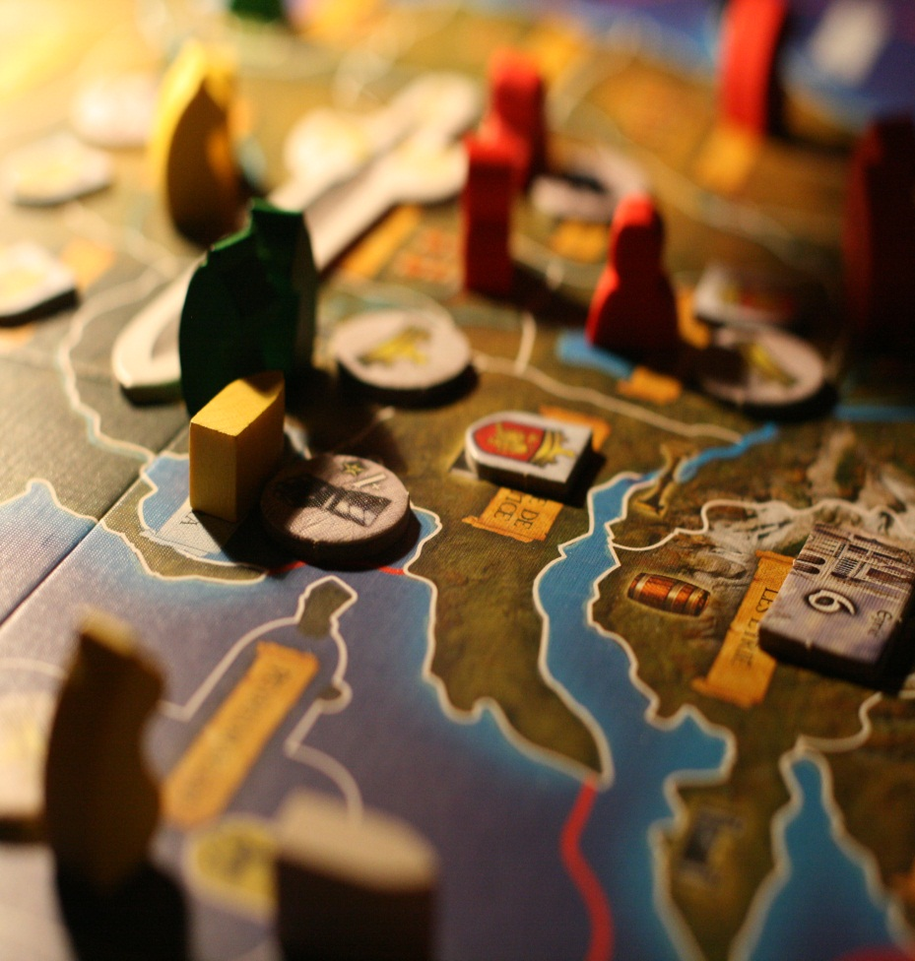
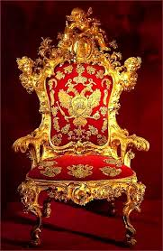
1.
Create a simile about a teacher
2.
What is this? ;
3.
What kind of word is a noun?
4.
What is a triple or the rule of three?
9.
Can you name an 12 letter literary device beginning with O?
6.
Give an example of using apostrophes for contractions.
7.
What is the antonym of argue ?
8.
Unscramble
this word.
Y D R C T I N I O A
5.
Pronounce
the word
Hyperbole

Slide 3
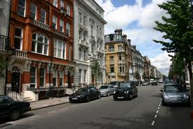
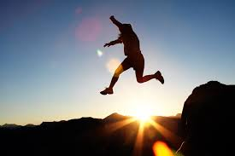
1.
What is a preposition ?
2.
Give an example of an indefinite article?
3.
Use hyperbole to describe your favourite film.
4.
Give a biased opinion about a football or rugby team.
5.
Unscramble this word.
EGALUNGA
6.
Name three connectives.
7.
What is an anecdote?
8.
What kind of word is verb?
9.
Name a famous advertising slogan.

Slide 4
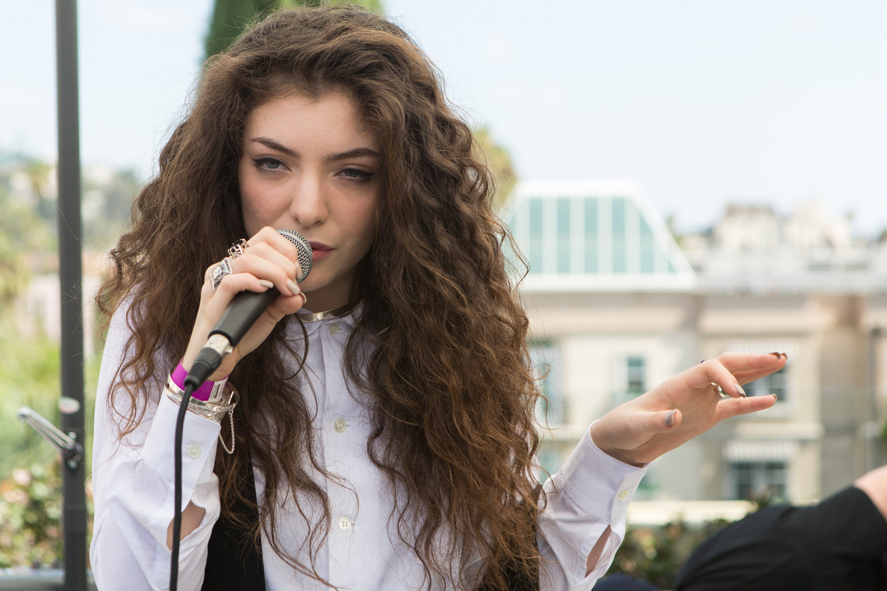
1.
Describe London using three adjectives.
2.
How many syllables are in the word statistic?
3.
Unscramble this word.
T O Y P E R
4.
Give an example of a homophone.
5.
What is a rhetorical question?
6.
Name 3 synonyms for cold?
7.
What type of punctuation should you use when writing a list?
8.
When should you start a new paragraph?
9.
What is a superlative ?

Slide 5
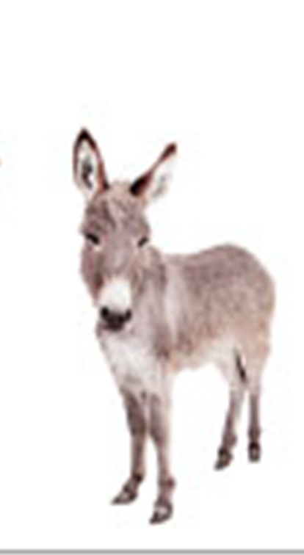
1.
What is alliteration?
5.
Give a definition of onomatopoeia.
3.
Think of a word with no vowels.
4.
What are these called?
“ “
2.
… is called ?
6.
‘He was a tiger in the tackle’ is an example of what?
7.
Name three times you always need to use a capital letter.
8.
What does an adverb do ?
9.
Name three Pronouns.

Slide 7
